Slide 1
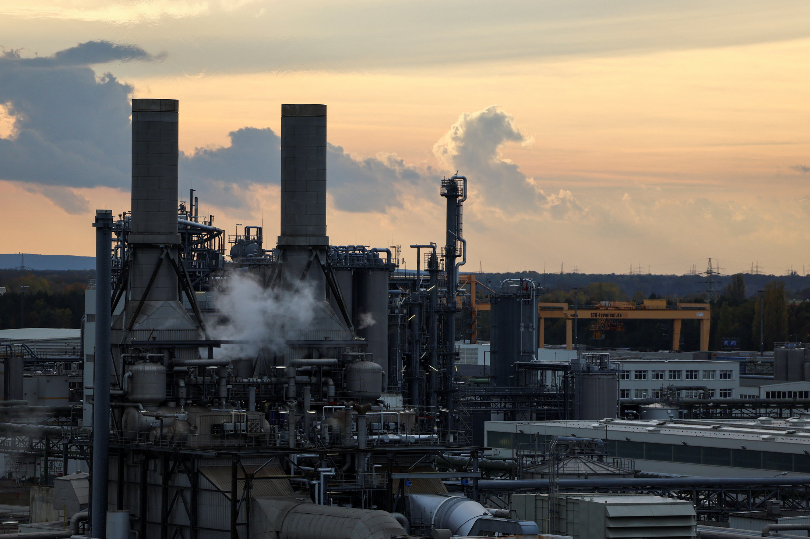



MANUFACTURING OF ACETONE
PLANT DESIGN AND LAYOUT
SUBMITTED TO:-
DR. SACHIN MANDAVGANE (PROFESSOR)
DEPT. OF CHEMICAL ENGINEERING
VISVESWARAYA NATIONAL INSTITUTE OF TECHNOLOGY, NAGPUR

Slide 2
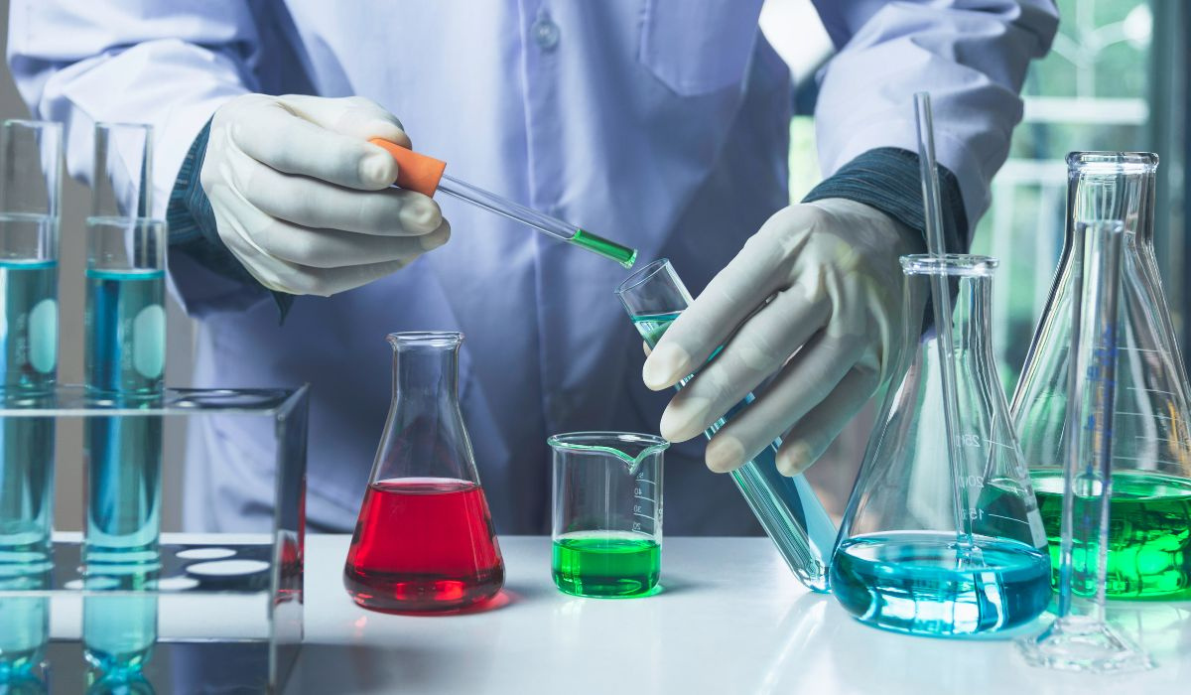
OUR TEAM
ROHAN SWAIN(BT23CME020)
KAUSTUBH MAHAJAN(BT23CME093)
VISHAL PATIL(BT23CME106)
PRIYAM (BT23CME096)
AMIT PATRA(BT23CME085)
SAURABH CHAVAN(BT23CME105)
SOHAM KARVE(BT23CME091)
ASHISH KUMAR(BT23CME109)
ATHARVA JOSHI(BT23CME025)
CHAITANYA TALE(BT23CME016)
VIVEK KUMAR(BT23CME027)
VEDANT ROKADE(BT23CME015)
ANSHUL LOKHANDE(BT23CME010)

Slide 3
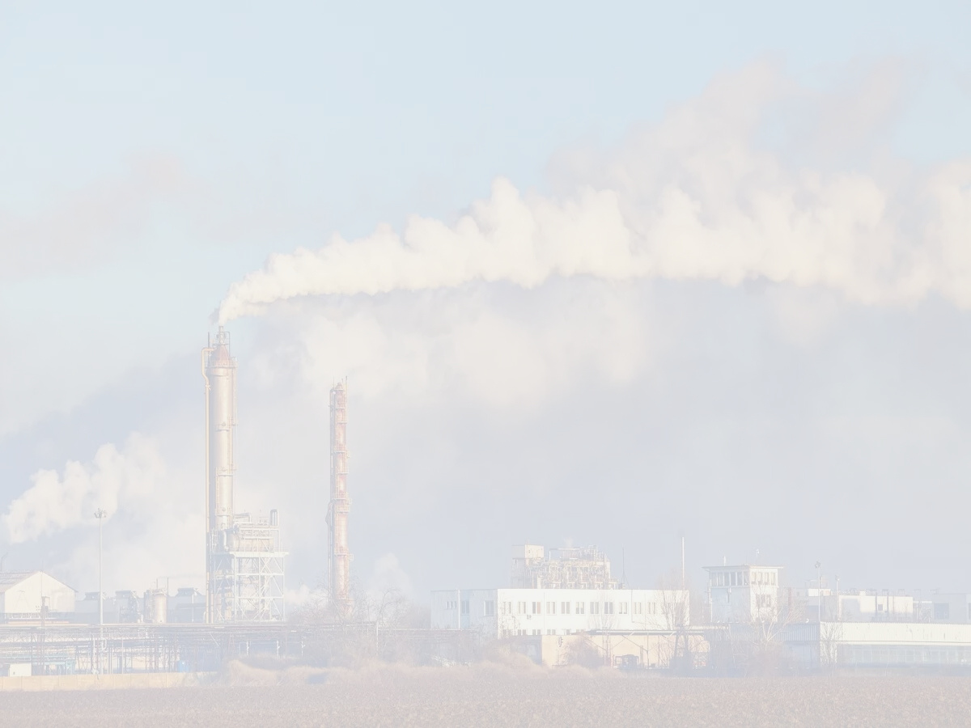
ACKNOWLEDGEMENT
We are deeply honored to have had the opportunity to design a storage vessel and a plant for manufacturing acetone from cumene, derived from propylene and benzene, gaining valuable insights into industrial-level planning and operations.
This project served as an excellent platform to enhance our knowledge and explore various aspects of the subject in depth.
We extend our sincere gratitude to Professor Sachin Mandavgane for assigning us this engaging topic and for his continuous guidance and support.
We are thankful to our peers for their constructive feedback and valuable inputs throughout the project.
Lastly, we express our heartfelt thanks to our parents for their subtle yet significant contributions, encouraging and supporting us during the project design process.

Slide 4
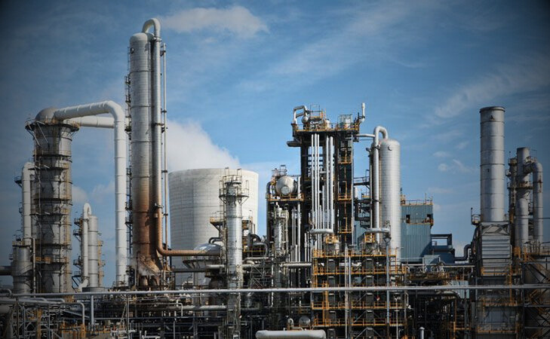

CONTENT
01
02
03
04
INTRODUCTION
STRUCTURE
USES
PROPERTIES-PHYSICAL AND CHEMICAL
REACTIONS
REACTION MECHANISM
REACTION TYPE
PROCESS DESCRIPTION AND CALCULATIONS
PROCESS FLOW DIAGRAM
DESCRIPTION OF UNIT PROCESS
MATERIAL BALANCE AND ENERGY BALANCE
AGITATOR
DISTILLATION COLUMN
05
06
07
08
PLANT DESIGN AND CALCULATI0N
STORAGE TANK
CSTR DESIGN
DISTILLATION COLUMN
GRAVITY DECANTER
PIPES AND PUMPS
SAFETY
PLANT LAYOUT
BIBLIOGRAPHY

Slide 5
INDEX
List of tables
List of Figures
Chemical to be manufactured(Acetone)
Physical and Chemical Properties
Chemical Reaction
Process Flow Diagram
Process Description.
Material Balance Calculations
Energy balance calculation
Section wise design calculation
1.Storage tank
2.Piping
3.Pumps
4.Reactors
Another equipment based on the Process flow diagram
Results in a tabular form
Sr No | Tank No | Chemical to store | Capacity | Dimensions | Thickness |
Safety
Plant Layout
Bibliography

Slide 6
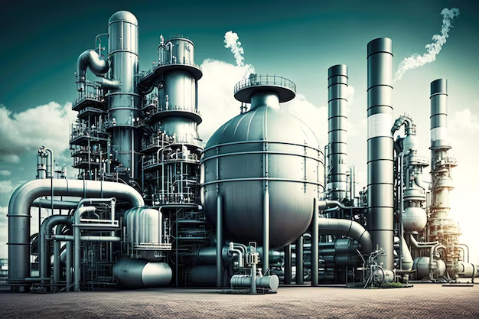
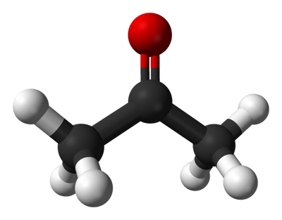
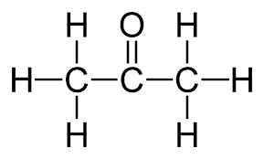
1.INTRODUCTION
What is Acetone?
Acetone (propanone) is the simplest and smallest ketone. It is a colorless, volatile liquid with a characteristic sweet odour.
Importance:
Widely used as an organic solvent in various industries.
Plays a significant role in chemical synthesis.
Molecular Formula: C₃H₆O
Other Names: Propanone, Dimethyl Ketone

Slide 7
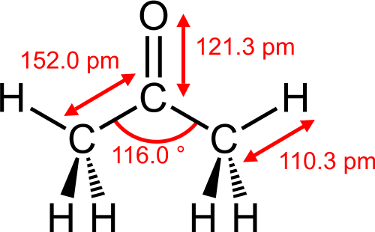
1.INTRODUCTION
1.1 Structure
Molecular Formula: C₃H₆O
Molecular Geometry: Trigonal planar around the carbonyl carbon.
Structure Diagram:
Functional Group: Ketone (-C=O)
Bond Angles: Approximately 120° around the carbonyl group.

Slide 8
1.INTRODUCTION
1.2 Uses
Industrial Applications:
Solvent for paints, varnishes, and adhesives.
Used in the production of plastics, fibers, and pharmaceuticals.
Laboratory Uses:
Common solvent for cleaning glassware and equipment.
Used as an extraction agent in organic synthesis.
Consumer Applications:
Main ingredient in nail polish removers.
Degreaser for household and industrial cleaning.

Slide 9
1.INTRODUCTION
1.3 Physical properties
State: Liquid
Color: Colorless
Odor: Sweet, pungent
Melting Point: −94.7 °C
Boiling Point: 56.05 °C
Density: 0.7845 g/cm³
Solubility: Miscible with water, alcohol, and most organic solvents.
Vapor Pressure: 231 mmHg at 25 °C
1.4 Chemical properties
Reactivity:
Combines with hydrogen to form isopropanol.
Oxidizes to acetic acid in the presence of oxidizing agents.
Stability:
Stable under normal conditions.
Highly flammable; vapors form explosive mixtures with air.
Combustion Reaction:
C₃H₆O + 4O₂ → 3CO₂ + 3H₂O

Slide 10
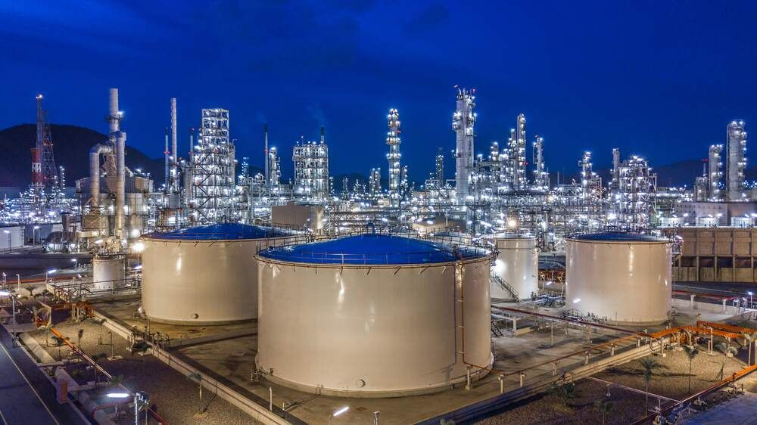
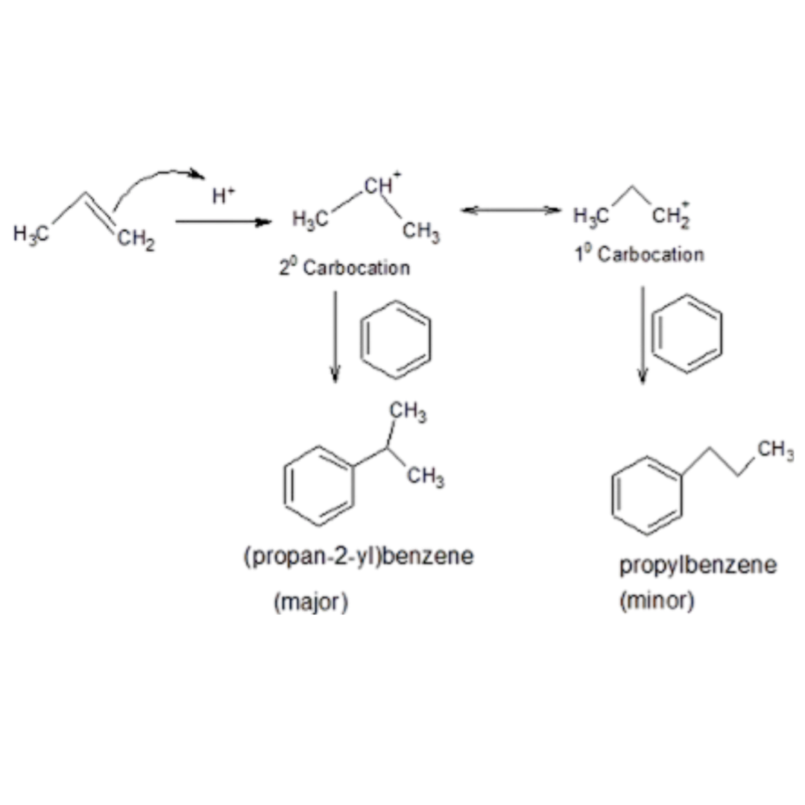
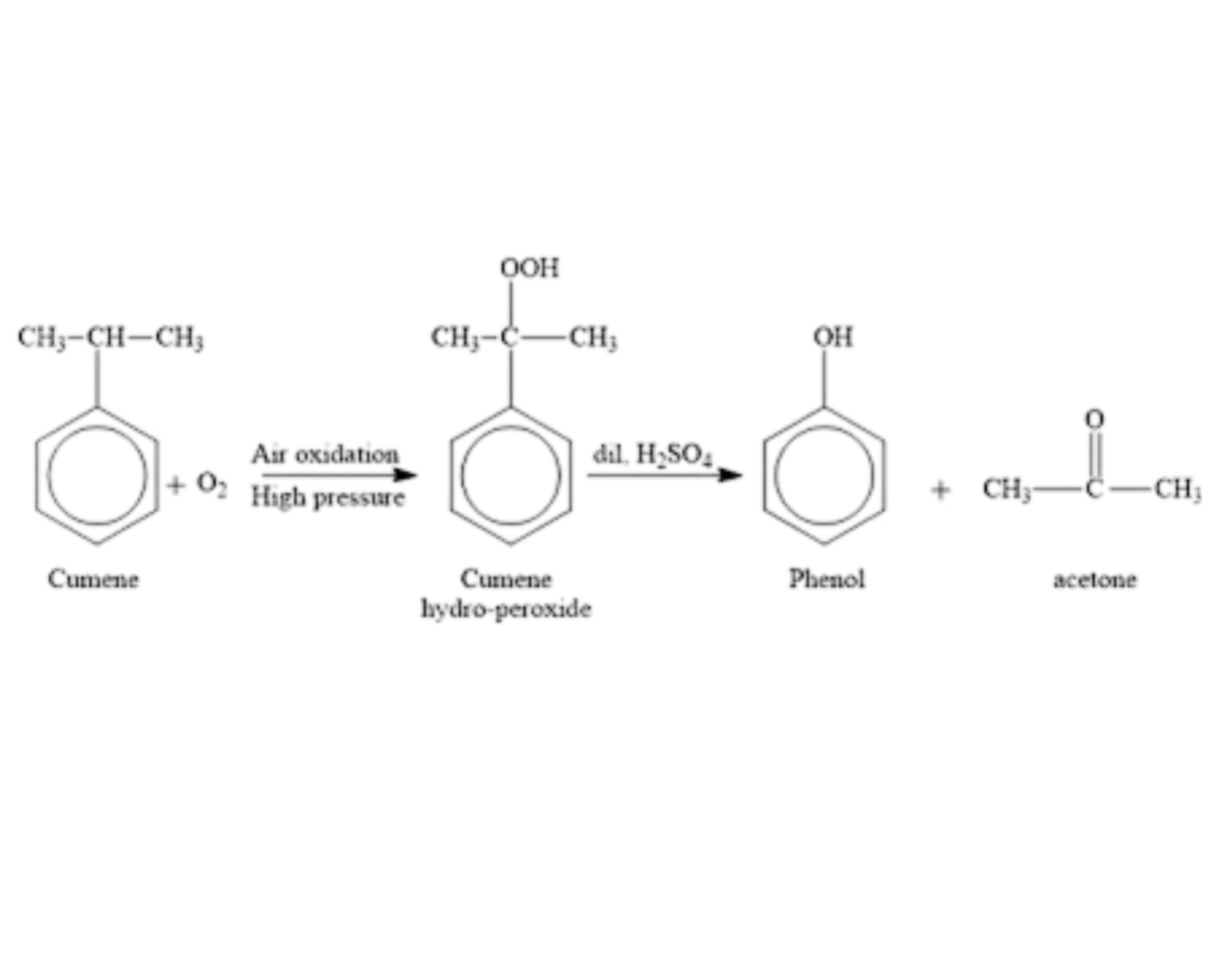
2.REACTION
2.1 REACTION MECHANISM
Benzene and isopropylene react to form cumene:
Cumene is oxidized to produce cumene hydroperoxide and then hydrolysed to form phenol and acetone

Slide 11
2.REACTION
2.2 REACTION TYPE
The reaction of benzene with propylene to form cumene (isopropylbenzene) is an electrophilic aromatic substitution.
In this reaction, propylene is first activated by a Lewis acid catalyst (commonly aluminum chloride or a similar acid) to generate a carbocation intermediate.
This electrophilic species reacts with benzene, substituting one of its hydrogen atoms to form cumene.
The hydrolysis of cumene to produce phenol and acetone is known as the cumene process. This involves the oxidation of cumene with oxygen (air) to form cumene hydroperoxide, followed by acidic cleavage. The cleavage yields acetone as our desired product.

Slide 12
3. PROCESS DESCRIPTION
The industrial production of acetone (500 TPD) is integrated into the cumene process, where acetone and phenol are co-produced. Benzene undergoes alkylation with propylene in the presence of a Lewis acid catalyst to form cumene, with a benzene conversion efficiency of 98%. Cumene is oxidized with air at controlled temperatures (90–110°C) to produce cumene hydroperoxide (CHP), achieving a 94% single-pass conversion. The CHP is then cleaved under acidic conditions (50–70°C), yielding phenol and acetone. The reaction mixture is separated and purified through fractional distillation to recover high-purity acetone. Efficiency is maintained by recycling unreacted benzene and cumene, optimizing energy via heat integration, and ensuring environmental compliance.

Slide 13
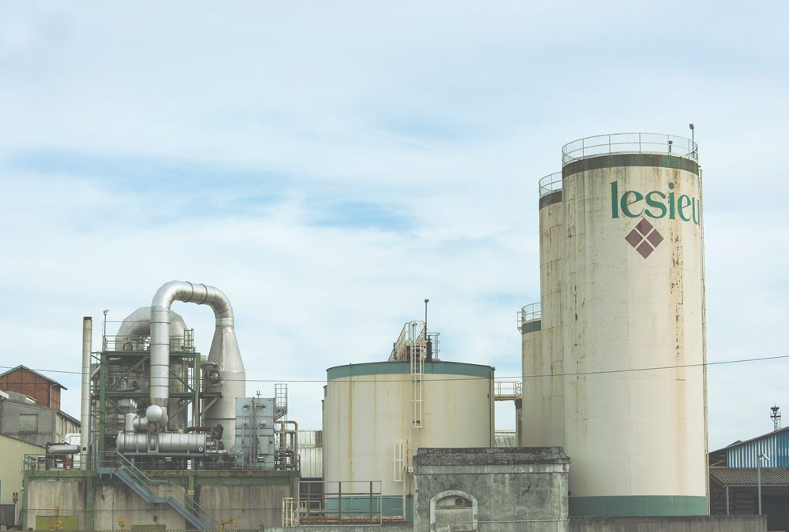
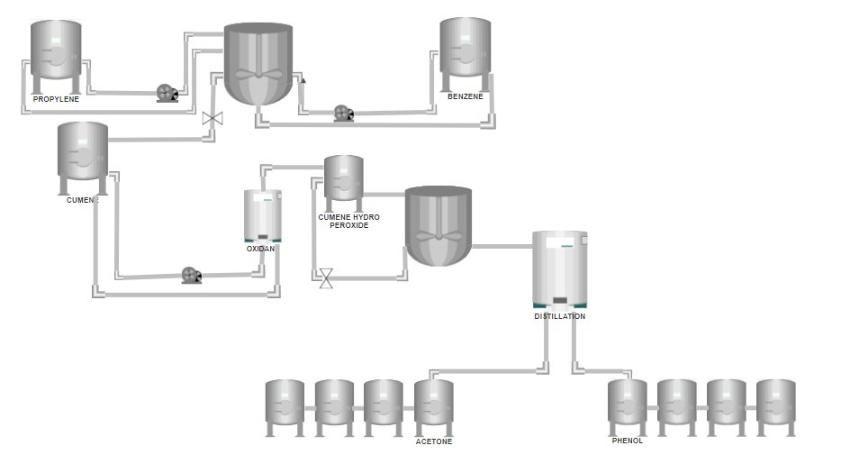
PLANT LAYOUT

Slide 14
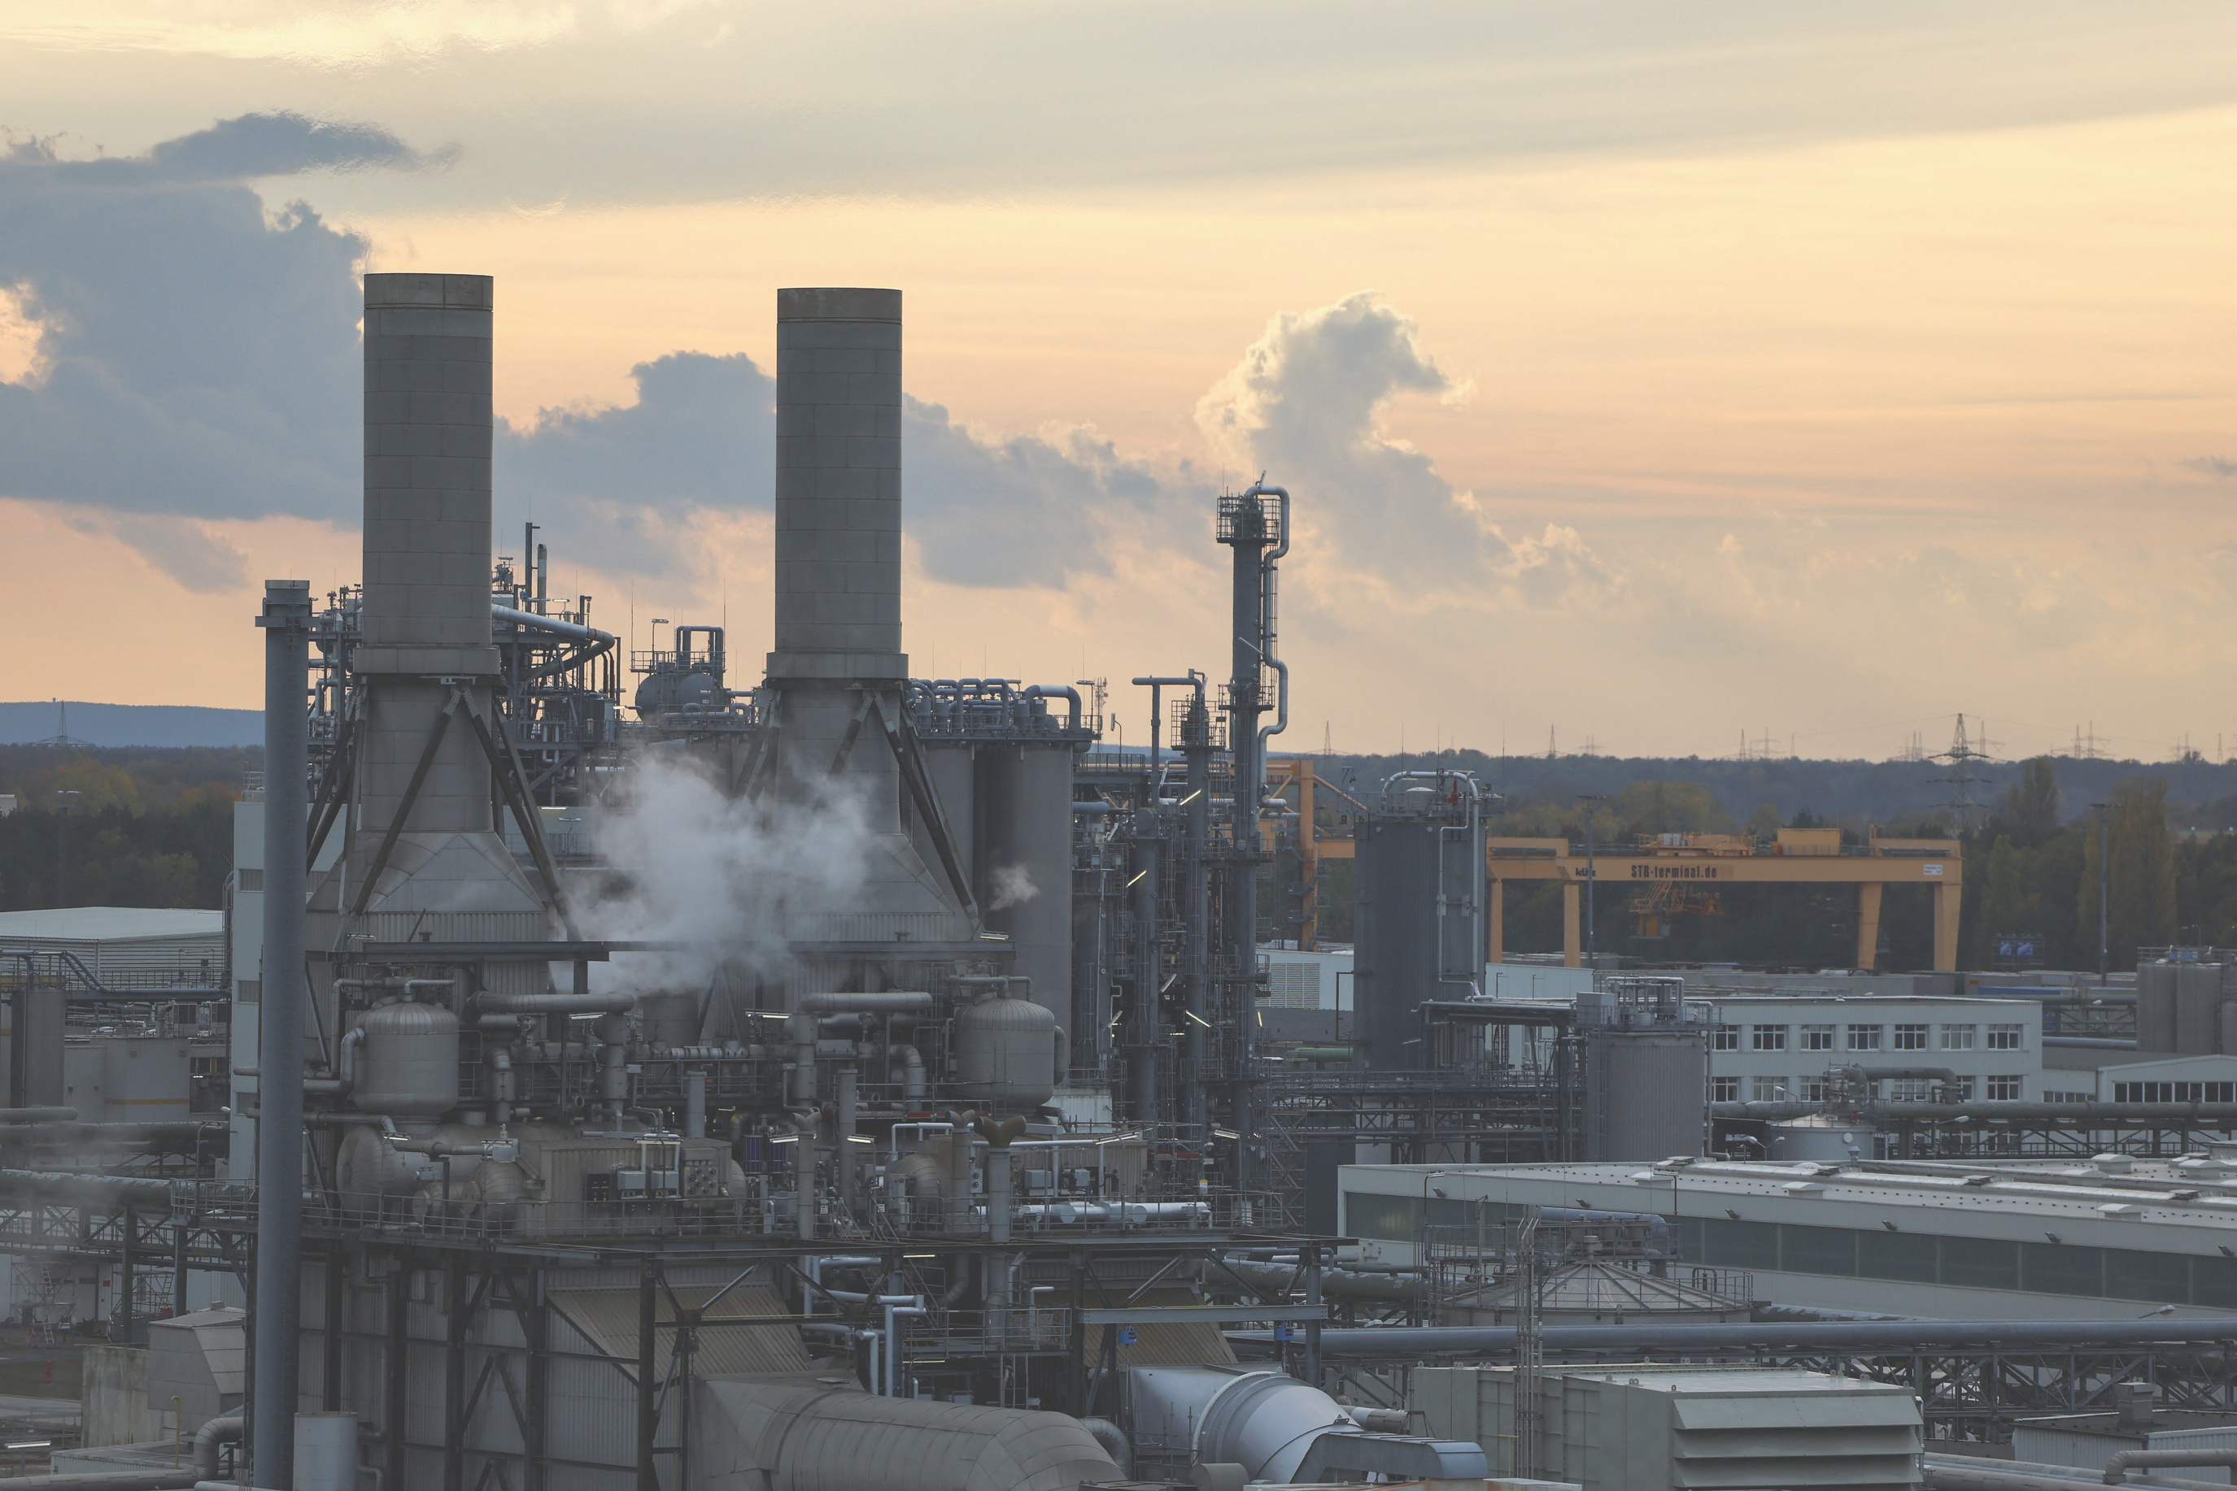
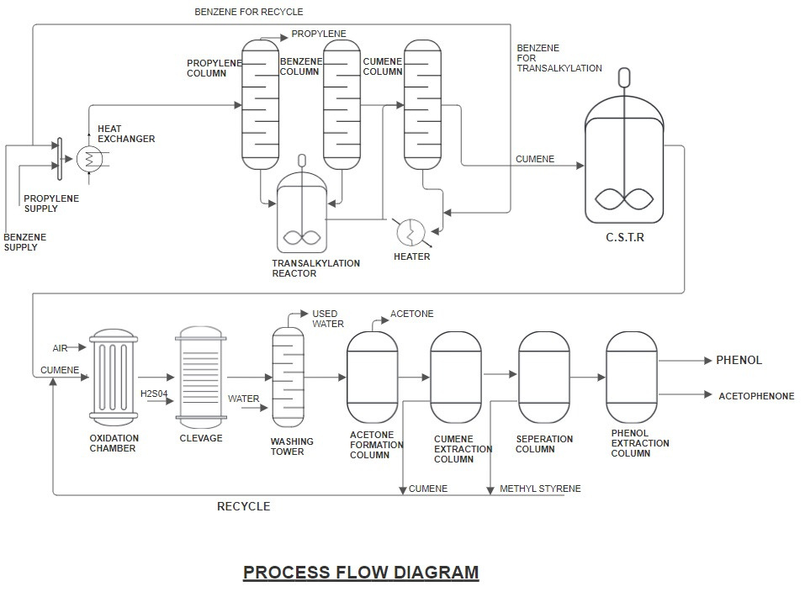
PROCESS FLOW DIAGRAM

Slide 15
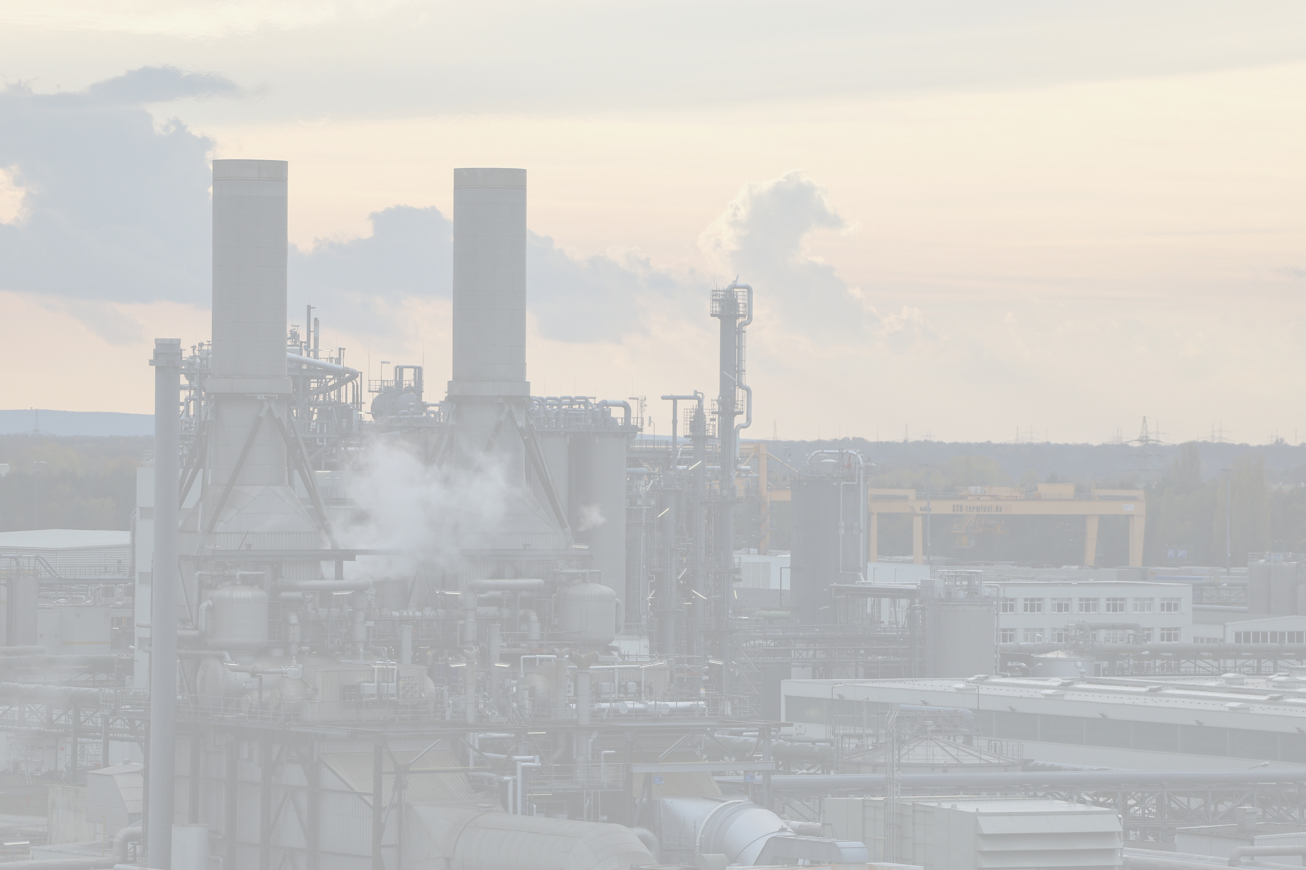
3.2 DESCRIPTION OF UNIT PROCESSES
3.2.1 DESCRIPTION OF STORAGE TANKS
BENZENE
PROPYLENE
CUMENE
ACETONE
BENZENE
BENZENE
BENZENE
Molecular Mass :78.11 g/mol
Density:0.874 g/ml
Melting Point: 278 K
Boiling Point: 353 K
Storage Tank Material: STAINLESS STEEL
Molecular Mass : 42 g/mol
Density: 1.036 g/ml
Melting Point: 87.95K
Boiling Point: 225 K
Storage Tank Material: STAINLESS STEEL
Molecular Mass :120.1 g/mol
Density: 0.864 g/ml
Melting Point: 177 K
Boiling Point: 425 K
Storage Tank Material: STAINLESS STEEL
Molecular Mass :58 g/mol
Density: 0.784 g/ml
Melting Point: 178 K
Boiling Point: 329 K
Storage Tank Material: STAINLESS STEEL

Slide 16
Material Balance Calculations
Acetone produced = 500 tonnes/day = 5x105 kg/day = 8620.57 kmol per day
Phenol produced = 97 tonnes/day = 8620.69 kmol/day = 810.34 tones/day =810344.9 kg/day
Conversion percentage of cumene hydroperoxide to phenol = 90%
Moles of cumene hydroperoxide = 8620.69/0.94 = 9170.25 kmol/day
Conversion percentage of cumene to cumene hyperoxide = 90%
Moles of cumene inlet= 22927.38 kmol/day
Conversion percentage of benzene to cumene = 98%
Moles of benzene inlet = 22927.38/0.98 = 23395.29 kmol/day

Slide 17
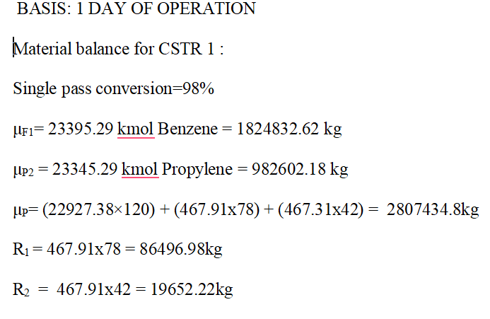
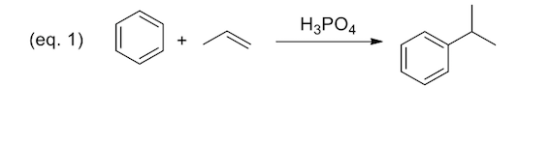
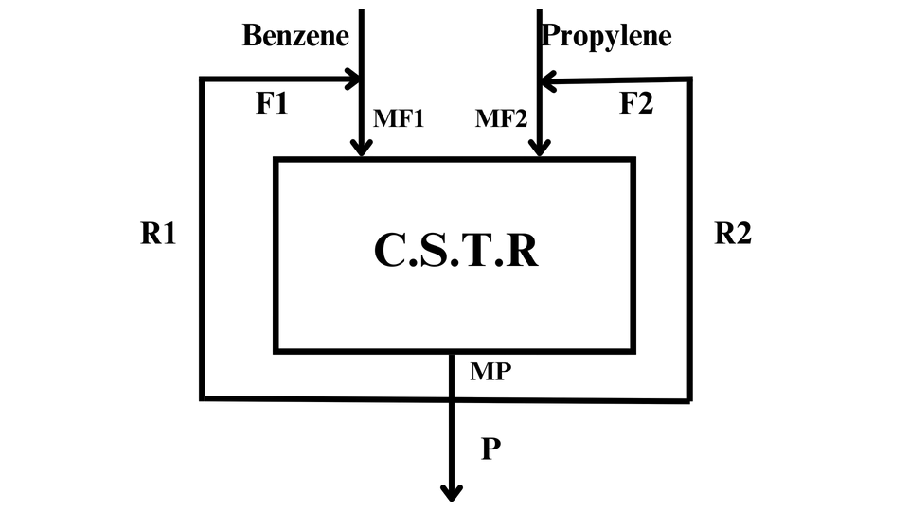

Slide 18
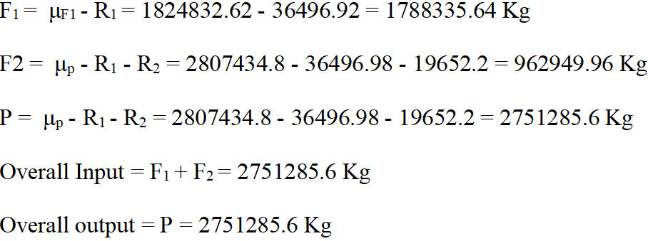
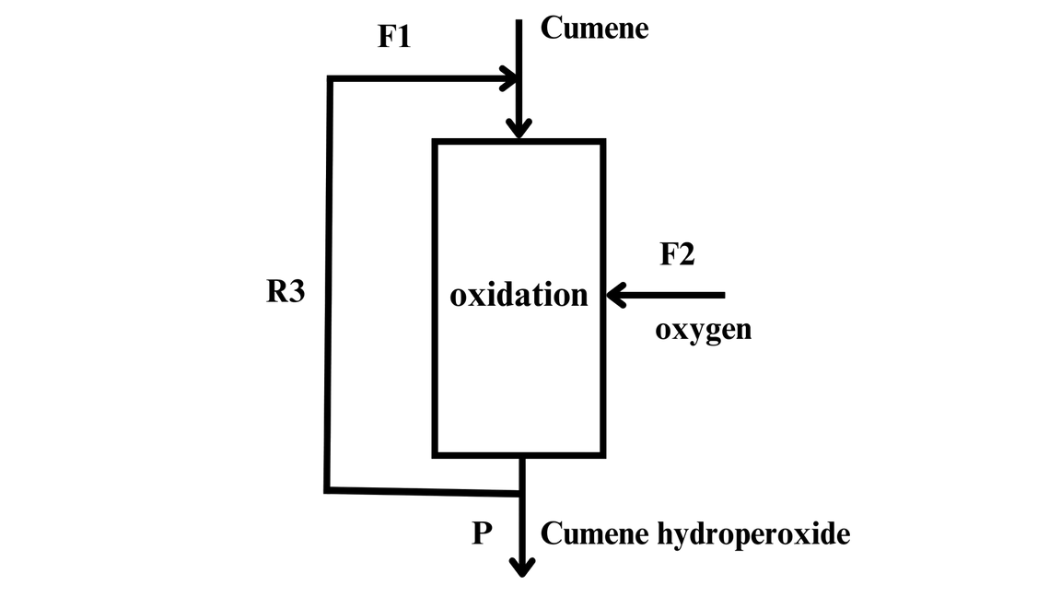
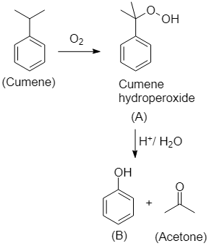
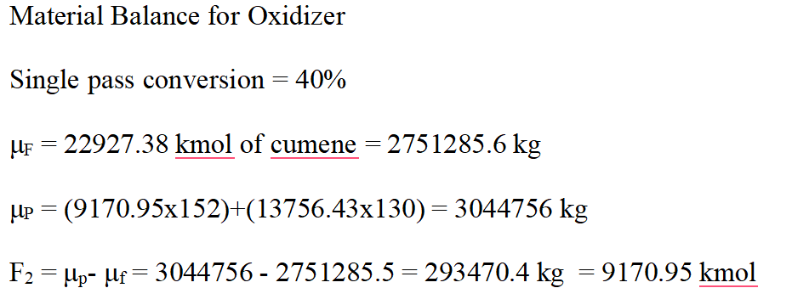

Slide 19
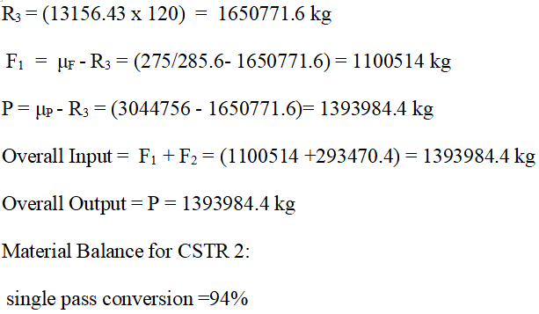
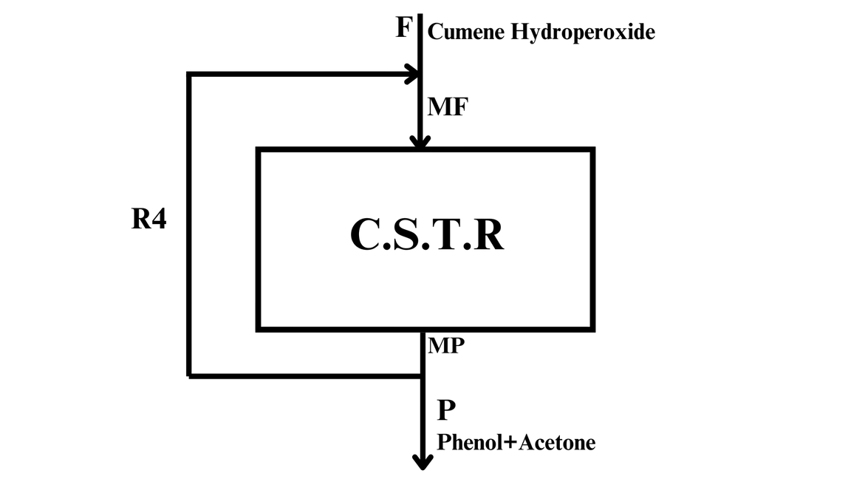
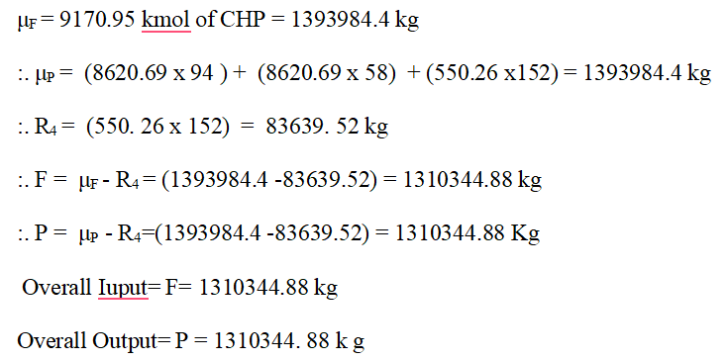

Slide 20
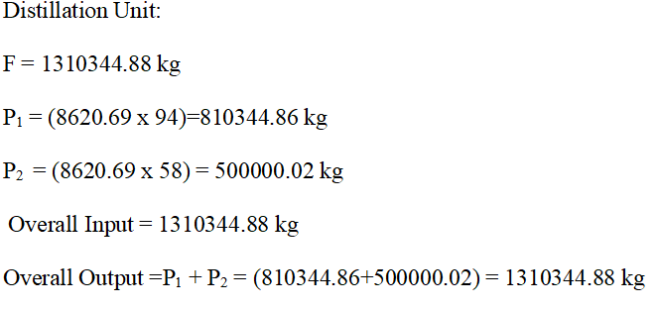

Slide 21
ENERGY BALANCE CALCULATIONS
Basis: For 1 day of operation
Equation for Energy Balance:
Q = ΔHout – ΔHin + r ΔHf
Where:
Q = Heat absorbed or released in the reactor
ΔHout = Change in enthalpy in the system out
ΔHin = Change in enthalpy in the system in
r = Rate of reaction, ΔHf = Heat of formation at 298.15 K

Slide 22
Enthalpy Change for Components:
Enthalpy change formula
𝑡2
ΔH=∫
𝐶𝑝.𝑑𝑡
𝑡1
ΔH = A(T2 - T1) + (B/2)(T2
2 - T1) + (C/2)(T2 – T
2
3
– T
)
) + (D/4)(T
3
2
4
1
4
1
Parameters:
•
•
T1 = Reference Temperature (298.15 K)
T2 = Input/Output Temperature

Slide 23
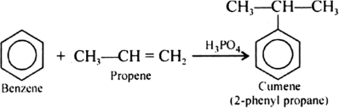
•
Examples of Components:
• • •
- Benzene: A=-0.206, B=29.064, C=-13.301
- Propylene: A=1.637, B=22.706, C=-6.915
- Cumene: A=0.189, B=0.538, C=-0.387, D=120.5x10^-7

Slide 24
Enthalpy Changes for inflow: T2=210℃ =483.15°K T1=298.15°K ΔHin=0
Enthalpy change for outflow:
T2=210℃ =483.15°K
T1=298.15°K

Slide 25
• For Benzene:
ΔH = (-0.206)(483.15 - 298.15) + (0.039064)(483.15² - 298.15²)/2 + (-0.000013301)(483.15³ - 298.15³)/3
Result: ΔH = 2.402 kJ/mol
• For Propylene:
ΔH = (1.637)(483.15 - 298.15) + (0.022706)(483.15² - 298.15²)/2
+ (-0.000006915)(483.15³ - 298.15³)/3
Result: ΔH = 1.7449 kJ/mol

Slide 26
• For Cumene:
ΔH = (0.139)(483.15 - 298.15) + (0.000538)(483.15² - 298.15²)/2
+ (-0.000000397)(483.15³ - 298.15³)/3 + (120.5 × 10⁻12)(483.15⁴ - 298.15⁴)/4
Result: ΔH = 0.546 kJ/mol

Slide 27
•For overall enthalpy at inflow:
ΔHin=0
For overall enthalpy at outflow:
ΔHout = 2.402 × 467.91 × 10³ + 1.7249 × 467.91 × 10³
+ 0.546 × 22927.38 × 10³
Result: ΔHout= 14458.732 × 10³ kJ/day.
• Heat of Formation:
= (-411 × 22927.38 × 10³) - (-49.08 × 467.91 × 10³

Slide 28
+ 19.710 × 467.91 × 10³ - 28.5 × 467.91 × 10³)
Result: -961167.5 × 10³ kJ/day.
• Overall=-946708.77 × 10³ kJ/day (Exothermic).

Slide 29
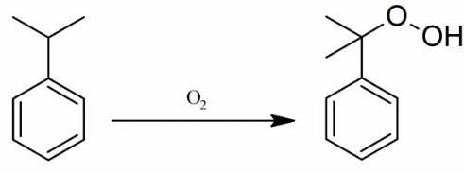
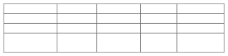
•
Reaction:
10^6C
-0.3979
-0.00671
-
Compounds cummene Oxygen Cumene hydroperoxide
A
10^3B 0.5376 0.01158 3.8060*105
10^-5D 120.5*10
17
0.1392 0.0291 1.345*105
1.311*10 -
-12

Slide 30
Enthapy change for inflow:
•
Temperature Details:
(T₁ = 298.15 K T₂ = 383.15 K = 110°C)
For Cumene:
•
ΔH = (139.2×10⁻³)(383.15 - 298.15) + (53.76×10⁻⁵)(383.15² - 298.15²)/2+ (-39.79×10⁻⁸)(383.15³ - 298.15³)/3 + (120.5×10⁻¹²)(383.15⁴ - 298.15⁴)/4
Result:ΔH = 23.864 kJ/mol
•

Slide 31
•
For Oxygen:
ΔH = (29.1×10⁻³)(383.15 - 298.15) + (1.158×10⁻⁵)(383.15² - 298.15²)/2 + (- 0.606×10⁻²)(383.15³ - 298.15³)/3 + (1.211×10⁻¹²)(383.15⁴ - 298.15⁴)/4
•
Result:
ΔH = 2.753 kJ/mol

Slide 32
Enthapy change for outflow:
•
Temperature Details:
((T₁ = 298.15 K
T₂ = 383.15 K = 110°C)
• Components analyzed:
Cumene Hydroperoxide
Cumene
Oxygen

Slide 33
• Detailed Results: Cumene Hydroperoxide & Cumene
• Cumene Hydroperoxide:
ΔH = (1.345 × 10⁵)(388.15 - 298.15) + (3.806 × 10²)(388.15² - 298.15²)/2 Result: ΔH = 23.859 kJ/mol
• Cumene:
ΔH = (139.2 × 10⁻³)(388.15 - 298.15) + (58.76 × 10⁻⁵)(388.15² - 298.15²)/2 + (-39.79 × 10⁻⁸)(388.15³ - 298.15³)/3 + (120.5 × 10⁻¹²)(388.15⁴ - 298.15⁴)/4
Result:
ΔH = 25.336 kJ/mol

Slide 34
• Oxygen:
ΔH = (29.1 × 10⁻³)(388.15 - 298.15) + (1.158 × 10⁻⁵)(388.15² - 298.15²)/2+ (-0.6076 × 10⁻⁸)(388.15³ - 298.15³)/3 + (1.311 × 10⁻¹²)(388.15⁴ - 298.15⁴)/4
Result:
ΔH = 2.917 kJ/mol

Slide 35
Overview of inflow, outflow, and heat of formation
Enthalpy Calculations (Inflow and Outflow)
:
• • • • • •
Overall Enthalpy for Inflow:
23.864 × 22927.38 × 10³ + 2.75 × 303.2 × 9170.95 × 10³
= 572386.9 × 10³ kJ/day
Overall Enthalpy for Outflow:
23.859 × 9170.95 × 10³ + 25.336 × 13756.43 × 10³ + 2.947 × 10³
= 567342.607 kJ/day

Slide 36
Heat of Formation and Overall Results:
For Heat of Formation: (-149.67 × 9170.95 × 10³) - (-41.1 × 22927.38*103)
= -1372616.09 × 10³ + 942315.318 × 10³ = -430300.772 kJ/day
Overall = (567342.607 - 572386.9- 430300.772) × 10³
= -435345.065 × 10³ kJ/day (Exothermic)
•

Slide 37
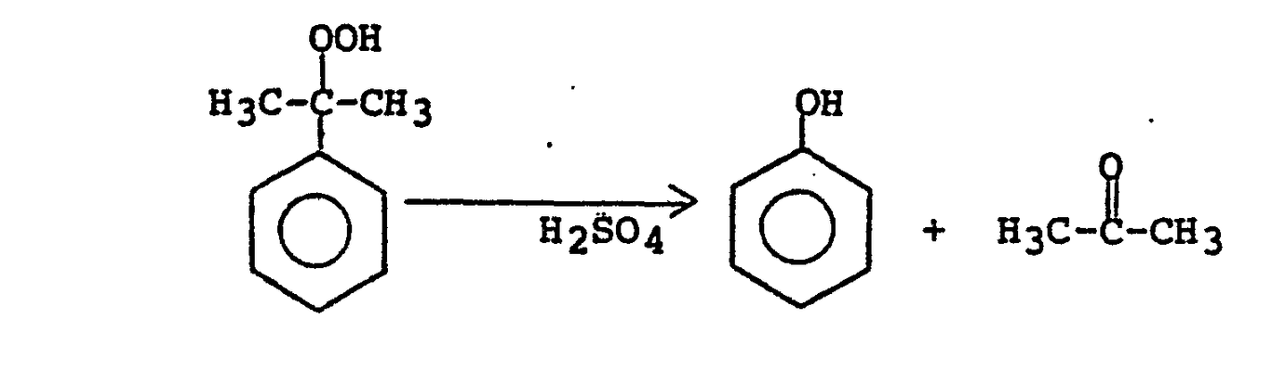
Reaction:
Compounds
A
10^3 B
10^6 C
10^ -5 D
Acetone
10.51
0.02199
-
1.57* 10^-15
Phenol
-158.755
4.964* 10^3
-2.442*10^3
-
Cumene HydroPeroxide
1.345*10^5
3.806* 10^5
-0.7931
-

Slide 38
Enthalpy change for inflow:
T₂=403.15 K
T = 298.15K
For Cumene HydroPeroxide:
ΔH = (1 * 345 * 10 ^ 5)(403 * 15 - 298 * 15) + (- 758 - 3 * 806 * 10 ^ 2)(403 * 15 ^ 2 - 298 * 15 ^ 2) / 2
= 42148.552 kJ/mol

Slide 39
= -1200 98.602 J/mol = -120-09 kJ/mol
Enthalpy change for outflow:
T₁ = 298.15 K
T₂ = 383.15 K
For Cumene HydroPeroxide:
ΔH= (1.345x105) (423.15-298.15)+(3.306*10 ^ 2)(423.15 ^ 2 - 293.15 ^ 2) / 2
=51128.348 J/mol = 51.128 kJ/mol
For Phenol:
ΔH=(- 158.755)(423.15 - 298.15) +(4 ..964)(423.15 ^ 2 - 298.15 ^ 2) /2 +(-2.442x10^-3) (423.15^3-298.15^3)/3
=-1200 98.602 J/mol = -120.09 kJ/mol

Slide 40
For Acetone:
ΔH= (10.5(1))(423.15 - 298.15) +(0.02199×10-3) (423.15^2-298.15^2)/2+
(-0.7931x10^-6) (423.15^3-298.15^3)/3+ (1.57*10 ^ - 10)(423 .5 ^ 4 - 298.15 ^ 4) / 4
= 1302.665 KJ/mol
[(-96*4*86 20 * 69 + (- 247.48) * 8620 * 69 ]-
[(- 149 * 67) * 9170 * 95] ]* sqrt 2 ^ 3 =-1591866-791×1KJ/day

Slide 41
STORAGE TANK CALCULATION
ACETONE :
V=( 5x10^5 )/(784)=637.75m^3/day
For 2 months = 637.75 m³/day *60 days
= 38265 m3
Considering buffer for one month and storage.
We are making four storage tanks of V= 38265/4 = 9565.25 m^3
Material==>> Stainless steel.
Dimensions of tank: (H/D)= 1.5
=> πr^2 H = 9566.25
=>(1.5/4)*πD^3 = 9566.25
D=9.33 m
H=9.33*1.5 = 13.995 m
Considering safety factor = 13.995*1.3 = 18.194 m = H
Thickness = 2.5 mm
1)ACETONE : V= (5*105)/784 = 637.5 M3/DAY
FOR 2 MONTHS = 631-75 M^3/DAY*60 DAYS
=38265 M
CONSIDERING BUFFER FOR I MOUTH AND STORAGE OF WATE WE ARE MAKING I STORAGE TANKS OF
V= 38765/4 = 9566.25
MATERIAL: STAINLESS STEEL.
DIMENSIONS OF TANK: (H/D)= 1.5
=PI*(R^2)*H = 9566-25 =10811.69
=15 JID3 = 9566-25 =D-9-33 Ш
=H=9.33X1.5 = 18.995 1
CONSIDERING SAFETY FACTOR = 13.995×1.3 = 18.194M = H

Slide 42
PHENOL:
V= 810344.9/1058 = 765.92 m^3/day
For 2 months = 45955.29 m^3
For 1 tank = 45955.291/4=11488.82 m^3
Material: Stainless Steel
Dimensions of tank: (H/D) = 1.5
=> π*r^2*H= 11488.82
=>(1.5/4) *π*D^3=11488.82
=> D^3=29752.01.
=>D=21.36 m
H=21.36 * 1.5 = 32.05 m
Considering safety factor= 32.05*1.3= 41.66m = H

Slide 43
CUMENE:
V = 2751285.6/862 = 3191.75 m^3/day
For 2 months = 191504.8 m^3
For 1 tank = 191504.8/4 =47876.2 m^3
Material: Stainless Steel
Dimensions of tank: (H/D) = 1.5
π*r^2*H=47876.2
(1.5/4)*π*D^3=47876.2
D^3=40638.6m^3
D=34.38 m
H=34-38×1.5=51.57 m
Considering safety factor= 51.5.7*1.3 = 67.044 m=H
Thickness: 36 mm

Slide 44
BENZENE:
V=1788335.64/876 = 2041.48 m^3/day
For 2 weeks=28580.72 m^3
For 1 tauk = 28580.72/4 = 7145.18 m^3
Material: Stainless steel
Dimensions of tank (H/D)=1.5
π*r^2*H=7145.18 m^3
(1.5)/4*π*D^3=7145.18
D=18.24 m
H=27.36 m
Considering safety factor:
21*1.3=37.57 m=H
Thickness = 10.77 mm
-

Slide 45
Cumene Hydroperoxide:
Cumene volume = 121328 m^3/day.
6 days volume= 72796.93 m^3day.
Divided in 4 tanks,
H/D =1.5
(1.5)*π*D^3/4=18199.23 m^3
D=24 m
H=37.36 m
Considering safety factor:
Hsafe = 37.36 *13
=48.573 m

Slide 46
PROPYLENE:
V=982602.18/480=2047.087 m^3/day
For 2 weeks =28659.2302 m^3/day
Considering 4 tanks:
For 1 tank = 28659.2302/4=7164.807
Material: Stainless Steel
Dimensions of tank (H/D) = 1.5
(1.5/4)*π*D^3=7164.807
D= 18.25 m
H=1.5*18.25=27.38 m
Considering safety factor:
1.3*27.38=35.594 m
Thickness = 5.65 mm

Slide 47
TABLE OF STORAGE TANK DIMENSIONS
STORAGE TANK | DIAMETER(M) | HEIGHT WITH 30% SAFETY FACTOR(m) | Thickness(in mm)
PROPYELENE(x4) | 18.25 | 35.5 | 5.65
BENZENE(x4) | 18.24 | 37.57 | 10.77
CUMENE(x4) | 34.3 | 67.044 | 36
CUMENE HYDROPEROXIDE | 24 | 37.57 | -
ACETONE(x4) | 9.3 | 18.1 | 2.5

Slide 48
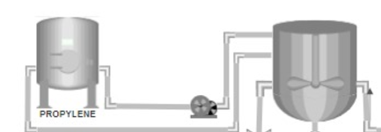
Pipe Section : 1-(Propylene to CSTR 1)
Assuming Velocity = 2m/sec
Density of Propylene ,ρ=480 kg/m3
Viscosity of Propylene , μ=5.02 x 10−3 Pa.s
CSTR-1
Volumetric flow rate ,Q =Mass flow rate(m)
Density
Mass flow rate = 518570.22 kg/day =6.0019 Kg/sec
Q =6.0019 kg/sec
=0.0125 m3/sec
480 kg/m3
Volumetric flow rate ,Q =Area (a) x Velocity (v)

Slide 49
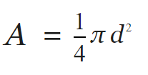
Area ,a = 0.0125
= 0.00625 m2
2
D=0.08921 m = 89.21 mm
Nominal Pipe Size Selection
From the Asme B36 10 standard , the closest pipe size is NPS 3 inches which has an outside diameter (D) of 88.9 mm .This is very close to our calculated diameter
Wall thickness ,t = PD
2σJ - p
P= 1.5 Mpa (design pressure)

Slide 50
Outside Diameter ,D = 88.9 mm
Joint efficiency ,σ=138Mpa
t = 1.5 x 0.088
2 x 138 -1.5
t=0.572 mm
Adding a corrosion allowance of 1.5 mm(typical carbon steel) for safety compilance
t=0.572+1.5=2.072 mm

Slide 51
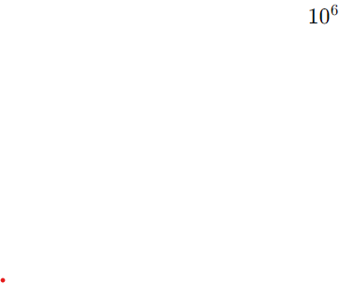
Selecting Pipe Schedule
Schedule 40 has a thickness of 3.91 mm (greater than our calculated)
Nominal pipe size 3 schedule 40 pipe is suitable for this applicaton
Pressure drop across pipeline
ε =0.015 mm
The length of pipe line = 34.6 m
Now,finding the value of head loss,
P/g=(4fL/D + K)x V^2/2g
4fL/D=34.13m
K=Minor losses and elbow losses=14.25
P/g=48.21x4/2x9.81=9.91m
Pressure head loss=9.91m
Pressure loss in pipe=164.38Kpa

Slide 52
PIPE SECTION-3:CSTR-1 TO CUMENE STORAGE TANK
Assuming velocity equals to 2m/s
Density of cumene at 110c=862kg/m^3
Viscosity of cumene = 0.79x10^-Volumetric flow rate =2751285.6kg/day=31.84kg/s
Q=31.84/862=0.0369m^3/s
Q=AxV
A=0.0369/2=0.0184=
3.14xD^2=4x0.01874
D=0.132=5.2inches
For 40 schedule pipe and NPS 5.5inches the thickness of pipe is 0.258mm
Length os pipe section is 67.03+5+1+1=74.03
3 Elbows are considered here
e/D=0.000046/0.13=0.0003538
Re=283696.2 flow is turbulent

Slide 53
Now,finding the value of head loss,
P/g=(4fL/D + K)x V^2/2g
4fL/D=4x0.017x74.03/0.132=38.136
Minor losses=14.5
p/g=(38.136+14.5)x4/(2x9.81)=11.46m
Pressure head loss=96.8Kpa
frictional head loss=7.74m

Slide 54
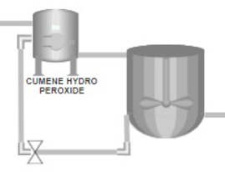
PIPE CALCULTIONS
SECTION 4:FROM CUMENE HYDROPEROXIDE TO CSTR-2
Weight of cumene hydroperoxide=1310344.88kg/day=15.16kg/s
Density of cumene hydroperoxide=1020kg/m^3
Viscosity of cumene hydroperoxide=0.077mPa
Volumetric flowrate=15.16/1020=0.0148m^3/s
Q=A x V
0.0148/2=0.00743=A
0.00743=3.14xD^2/4
D=0.097m=3.8 inches
For 40 schedule pipe of NPS 3.8' the thickness is 0.237mm
Length of pipe section=48.57+10+1+1=60.57
Reynolds number=(1020x2x0.097)/(0.077x10^-3)
R=2569870 the flow is turbulent
E/D=0.000046/0.097=0.000474
CSTR 2

Slide 55
From referring moody chart and finding value of frictional factor for Re and e/D
The value of frictional factor is 0.0136
Now,finding the value of head loss,
P/g=(4fL/D + K)x V^2/2g
4fL/D=33.96
K=Minor losses and elbow losses=14.25
P/g=48.21x4/2x9.81=9.83m
Pressure head loss=9.83m
Pressure loss in pipe=98.37Kpa

Slide 56
TABLE OF PIPE CALCULATION
PIPE SECTION | PIPE DIAMETER (inches) | PIPE LENGTH (m) | Z | frictional factor(f) | PRESSURE HEAD (m) | FRICTOINAL HEAD (m)
FROM PROPEYLENE TANK TO CSTR-1 | 3 | 34.4 | 22.4 | 0.022 | 9.91
FROM BENZENE TANK TO CSTR-1 | 4.8 | 34.4 | 22.4 | 0.0174 | 29.5 | 6.85
FROM CSTR-1 TO CUMENE TANK | 5.2 | 74.03 | 64.03 | 0.017 | 11.46 | 7.74
FROM CUMENE HYDROPEROXIDE COLUMN TO CSTR-2 | 3.8 | 60.57 | 48.57 | 0.0136 | 9.83

Slide 57
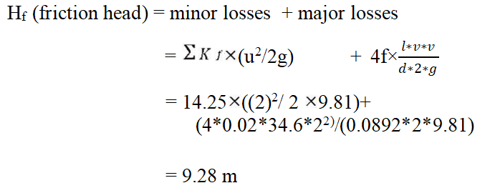
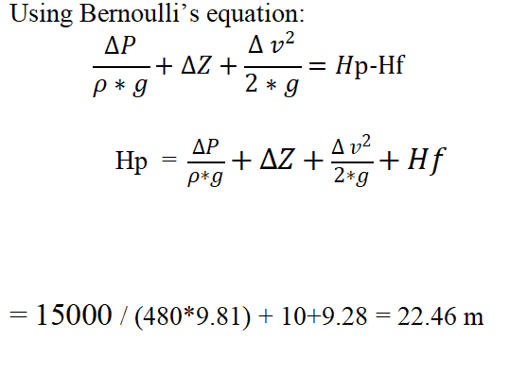
PUMP CALCULATIONS
Section 1 :
From Propylene storage tank to CSTR
Pipe: diameter = 0.0892 m
Volumetric flow Rate (Q) = velocity*area
=2 */4
=0.0125 m3/s
Material of Pipe: Stainless steel pipe
Length of pipe= 34.6 m
∆Z for pipe = 10 m
Pipe has three 90⁰ Elbows and 2 valves
Kf for 900 Elbows = 0.75
Kf for valve = 6
= (30.75 + 62) = 14.25
We have friction factor f = 0.02

Slide 58
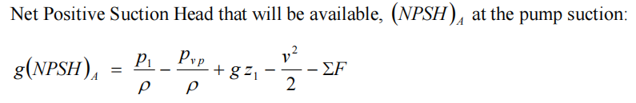
Power required
= m * g* Hp
= Q* *g*Hp
= 0.0125 * 480 * 9.81 * 22.46
= 1.321 kW
Considering pump to be 80 % efficient
Power required = 2.21 Hp
= (50000/480*9.81) + 10 - 9.3 - (4/2*9.81) = 9.746m

Slide 59
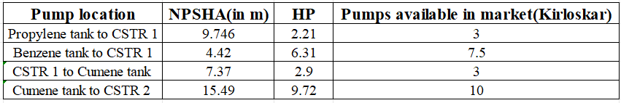
Pump calculations and results

Slide 60
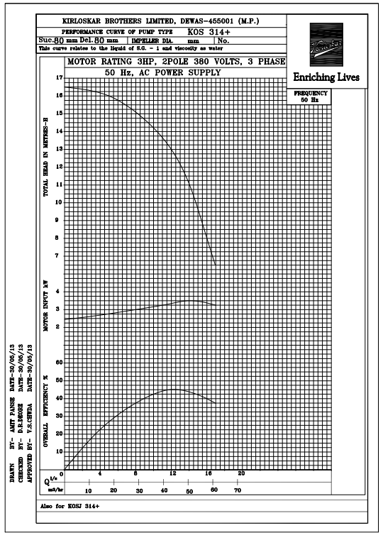
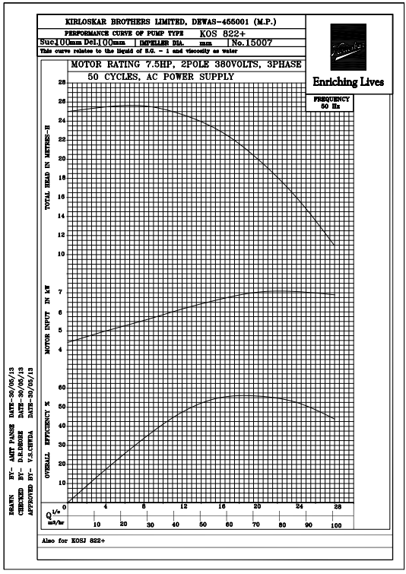
Kirloskar Pump performance curves

Slide 61
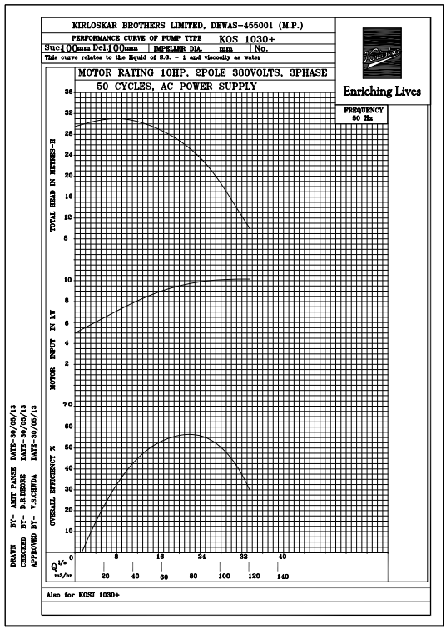

Slide 62
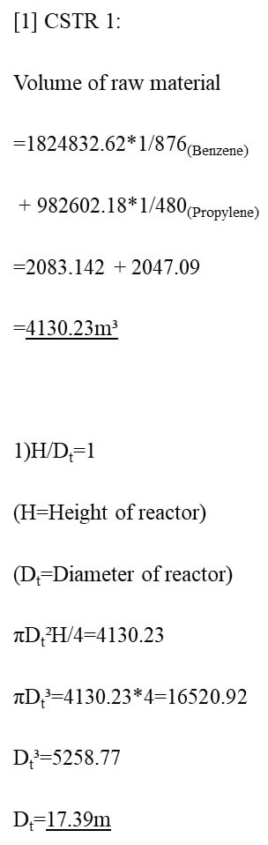
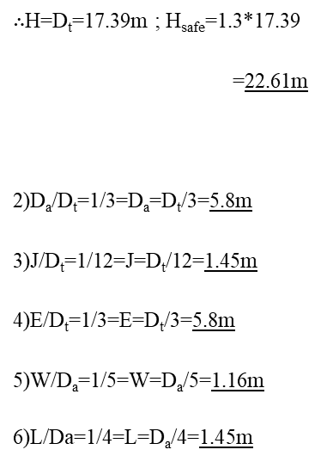
_-CSTR Calculations-_

Slide 63
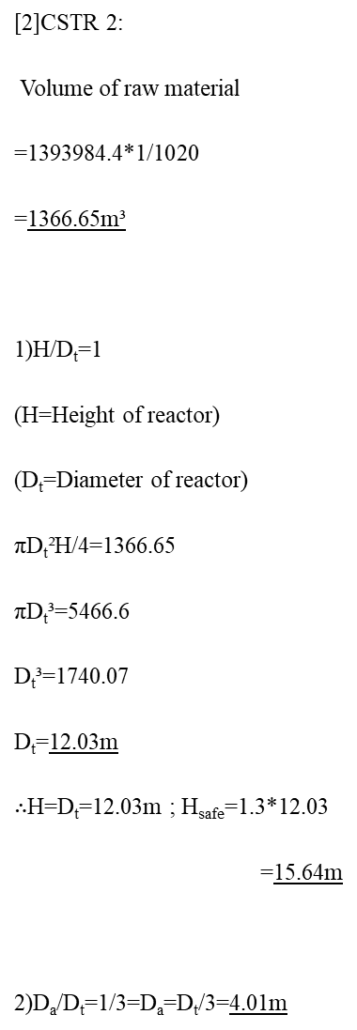
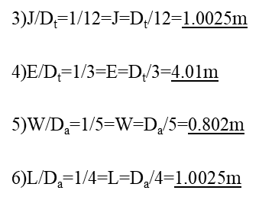

Slide 64
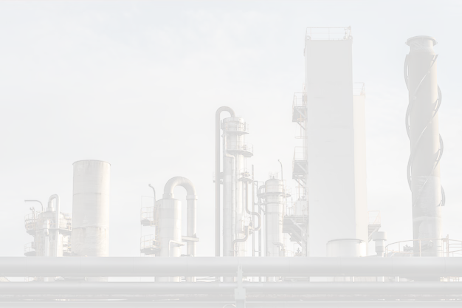
Safety Measures for Propylene Storage Tanks
Storing propylene requires strict safety protocols due to its flammable and pressurized nature. Key measures include:
1. Material Selection: Use corrosion-resistant stainless steel with high pressure tolerance.
2. Pressure Relief Systems: Install calibrated relief valves and emergency vents to prevent overpressure.
3. Fire Prevention: Use gas detectors, explosion-proof equipment, and fire suppression systems.
4. Temperature Control: Monitor and regulate tank temperature to avoid pressure buildup.
5. Emergency Systems: Provide automatic shutdown systems and accessible manual controls.
6. Spill Containment: Build bund walls or secondary barriers to contain leaks.
7. Inspections and Training: Conduct regular inspections and train staff on safety and emergency procedures.
8. Regulatory Compliance: Adhere to standards like API 620 and ASME Section VIII.
These measures ensure safe handling, environmental protection, and operational reliability.

Slide 65
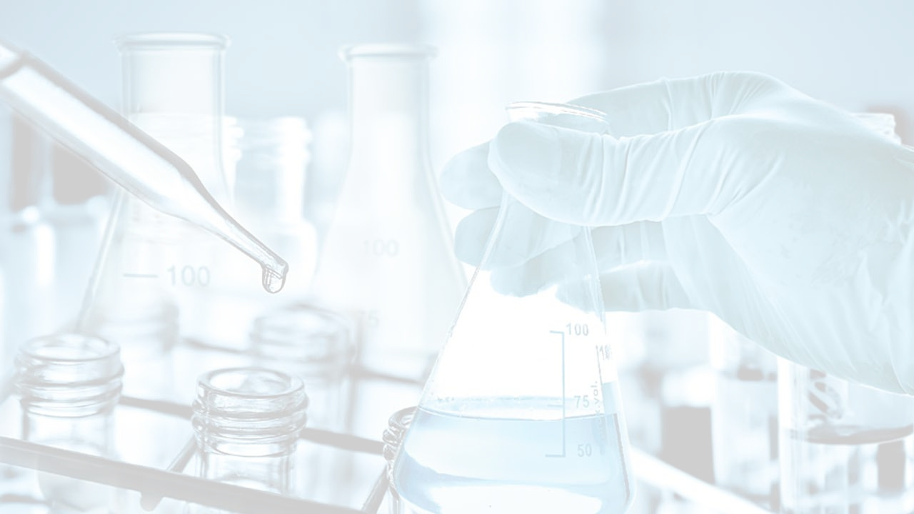
BIBLIOGRAPHY:
1.Fluid Mechanics for Chemical Engineers by Noel-de-Nevers.
2Analysis, Synthesis, and Design of Chemical processes by Richard turton
3.https://pubchem.ncbi.nlm.nih.gov/compound/Acetone
4.https://www.researchgate.net/publication/368661065_Acetone_Production_Process.
5.https://en.wikipedia.org/wiki/Acetone.

Slide 66
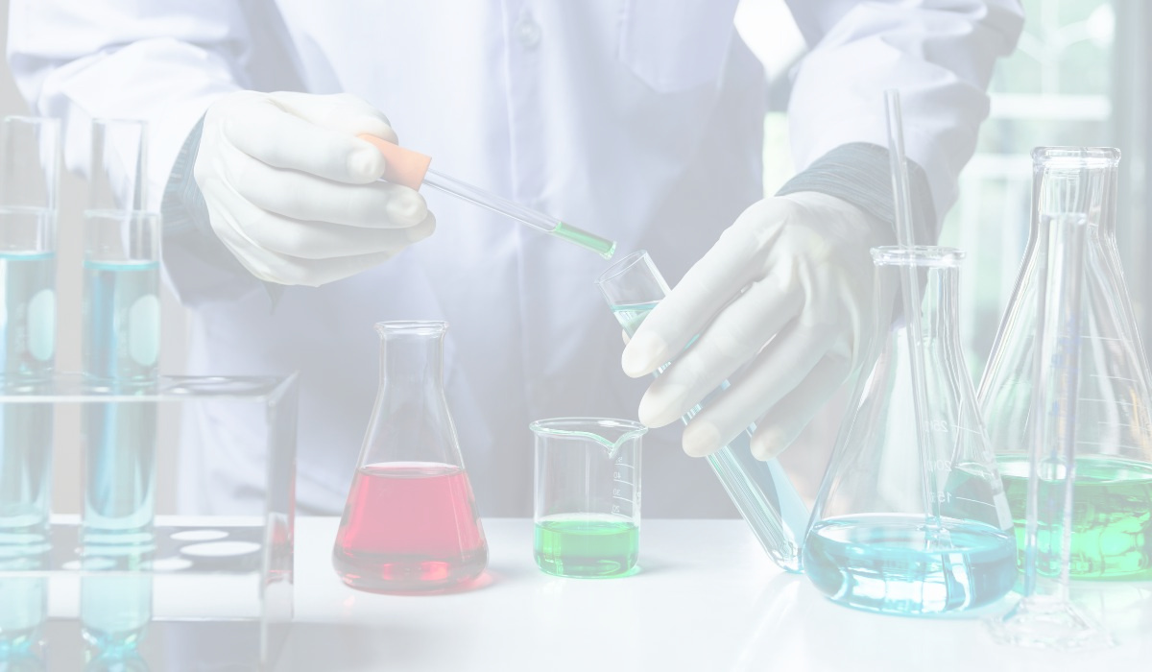
THANK YOU

